Slide 1
WHEN HEROS NEED HELP HEALING
Alyssa Killebrew, Ph.D.
Clinical Psychologist
Killebrew Psychological Services
Notes:
1. STORY OF SEEING HOMELESS MAN
2. My hero's 3. MACHO MEN and WOMEN
4. Run into the burning buildings
5. DADDY : root canal with no anesthesia than sit in a circle group and bare my soul to a group of strangers….

Slide 2
Hopes and Goals for You
Balanced in mind/heart, body and spirit
Attuned to self and needs
Notes:
WHAT IS IN IT FOR ME
AWARENESS
Balance
Best Version of yourself

Slide 3
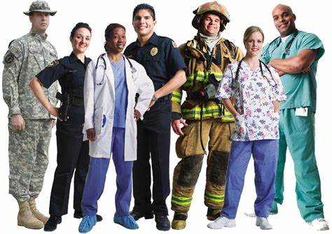
GENERATIONAL Trauma If you don’t do your work, your children and family will.
Notes:
I’ve been treating you guys for years…
I know your tough ; We know you are tough
A lot of you have family generational trauma
Mentally Healthy first responders deal with their stuff

Slide 4
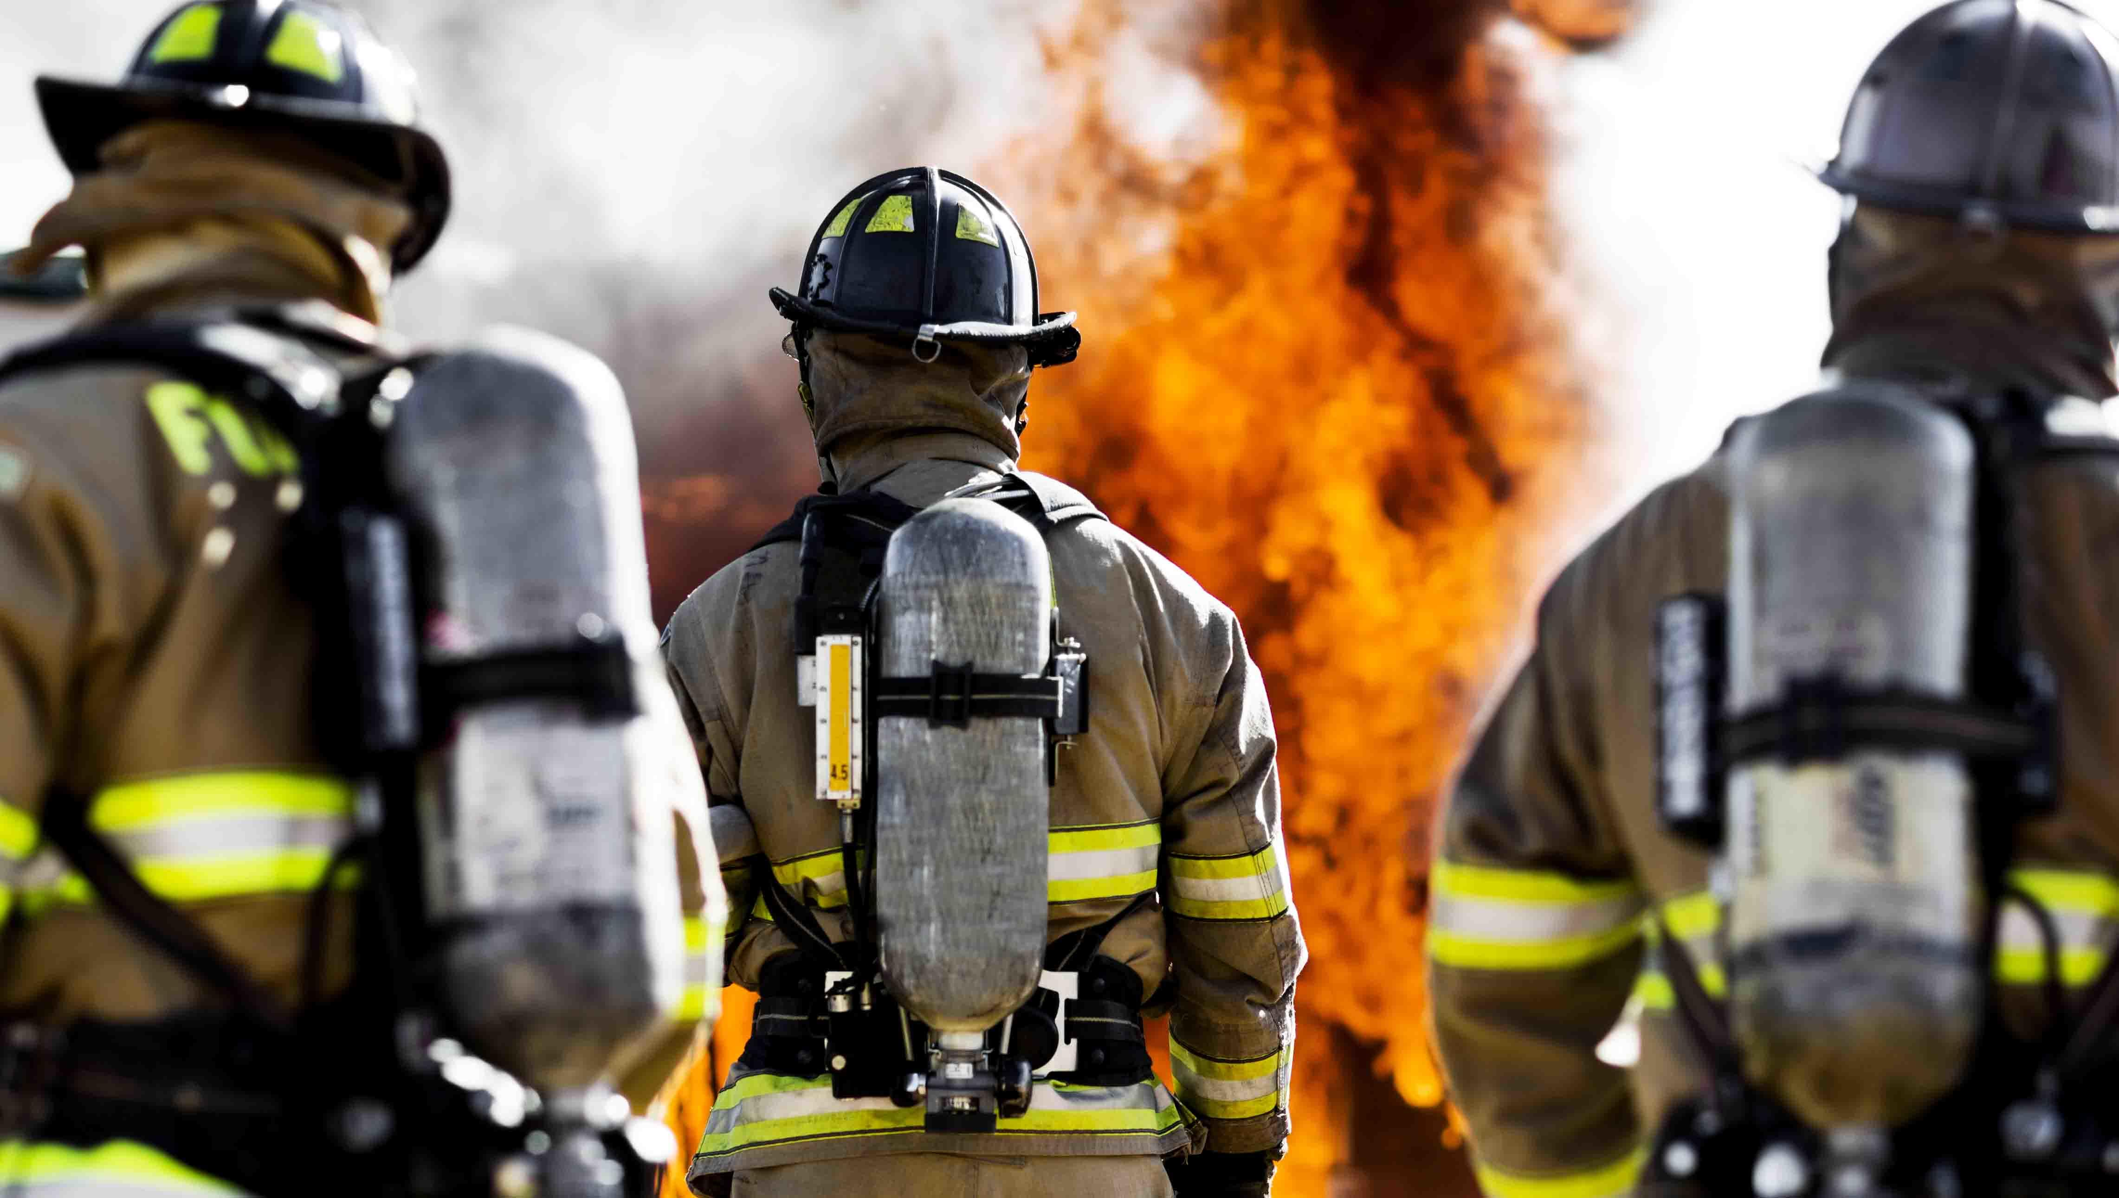
Highest risk for SUICIDE in First Responders:
Surgeon General’s “Call to Action to Implement the National Strategy for Suicide Prevention”
Notes:
Highest risk for SUICIDE in First Responders:
23% in male officers
Surgeon General’s “Call to Action to Implement the National Strategy for Suicide Prevention” highlighted suicides as a significant public health problem.
In 2020, there were 47,500 suicide fatalities in the U.S. and an estimated 1.4 million suicide attempts.
Officers with burnout showed significantly greater suicide risk, with a 117 percent greater likelihood of suicidal thoughts for officers who reported burnout at work

Slide 5
Put your oxygen mask on before putting it on your neighbor.
Notes:
IF YOU DON’T DEAL WITH OUR STUFF YOUR STUFF DEALS WITH YOU
You must learn how to put your oxygen mask on FIRST!!!!!!!!!!!!!!!!
ME FIRST

Slide 6
Notes:
WHEN TRAUMA IS YOUR JOB!!!!!!!!!!!!!!!!!!!!!!!
84% have experienced a Trauma. General population 8%
What is a Trauma
Anything Deeply Distressing that you can’t stop thinking about

Slide 7
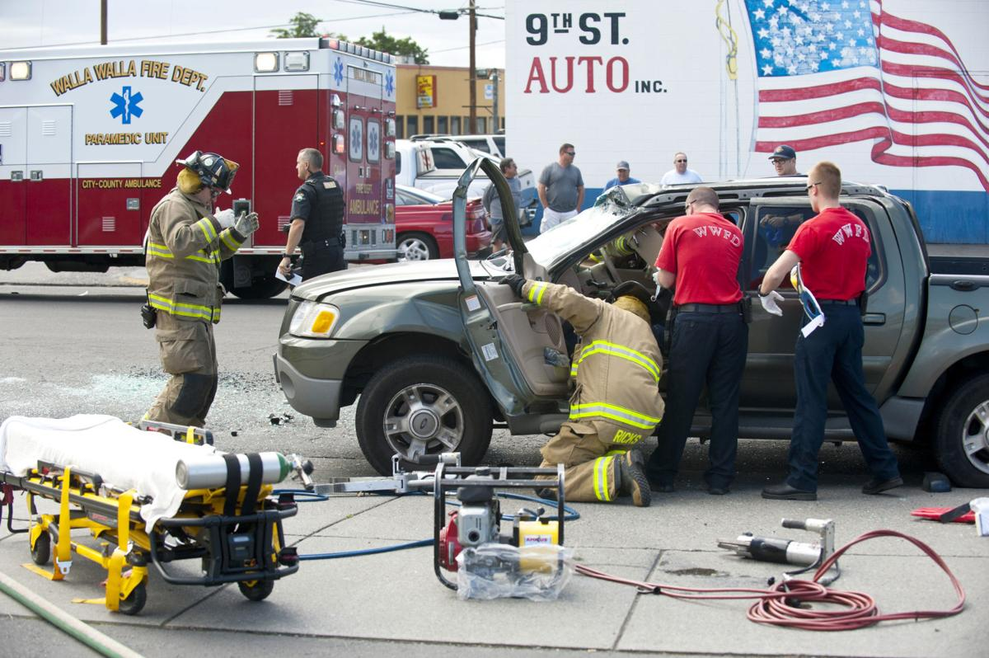
PTSD and First Responders
Symptoms: PTSD
Notes:
General population 7-12 in a lifetime. First responders acute or chronic is 27-32%
Signs of PTSD
1.Reliving the event, which can cause feelings of fear, nightmares, or the sense that you’re experiencing the event all over again.
2. Avoiding situations that serve as reminders of the trauma, such as not talking about the event, avoiding crowds or driving, or whatever else may remind you of what happened.
3. Experiencing negative changes in your emotions or beliefs, such as no longer having loving feelings toward other people, or taking on a negative worldview.
4. Feeling hyper-aroused, also known as feeling overstimulated. The VA refers to this as “feeling keyed up.” This sometimes causes you to feel very irritable, lose sleep, have trouble concentrating, or startle easily.

Slide 8
First Responders Diagnosed with PTSD
Notes:
General Population is 8%
32% in women at some point in their career
25% in men
50 % of firefighter deaths are due to untreated mental health diagnoses (SUD, Suicide)

Slide 9
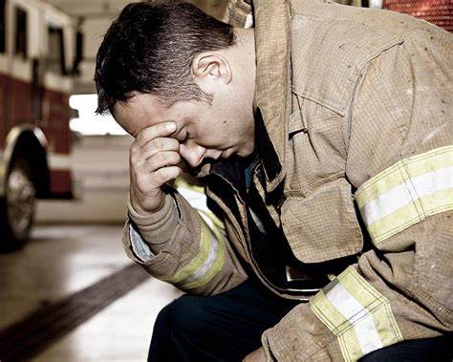
Depression
OCPD
Notes:
Depression:
Meta-analysis showed that 24.7-47.7% (after 9/11)
FITNESS FOR DUTY
I also know you present yourselves in a overly favorable light and
RESULTS: OCPD
Preoccupied with rules, overly devoted to work, perfectionistic, ridged and stubborn, reluctant to delegate
CONSEQUENCES
--HURTS Relationships

Slide 10
First Responders often have ATYPICAL Symptoms of Depression
Notes:
ATYPICAL DEPRESSION SYMPTOMS
Irritability
Loss of Energy
Anger
Substance abuse
Marital issues
Physical Health concerns
Heart issues
Fatigue
Cravings for sugar and/or carbs

Slide 11
Notes:
SUBSTANCE USE
SUD:
20-22% in Male Officer
11-15% in female officers Recent (past month) heavy or binge alcohol drinking was reported in approximately 50 percent of male firefighters, and driving while intoxicated was reported in 9 percent of male firefighters

Slide 12
When to seek out professional help
Notes:
Feeling numb or empty
Excessive worry and fear
Changes in Appetite
Difficulty Concentrating
Psychosomatic reactions: Headaches, chest pain, body aches, stomach problems, skin rashes
Excessive irritability
Loss of interest
Short Tempered or aggression
Increase in substance use or tobacco use
Withdrawal or isolation
Burnout
Poor self hygiene
No energy
If you are about to kill your spouse or children.

Slide 13
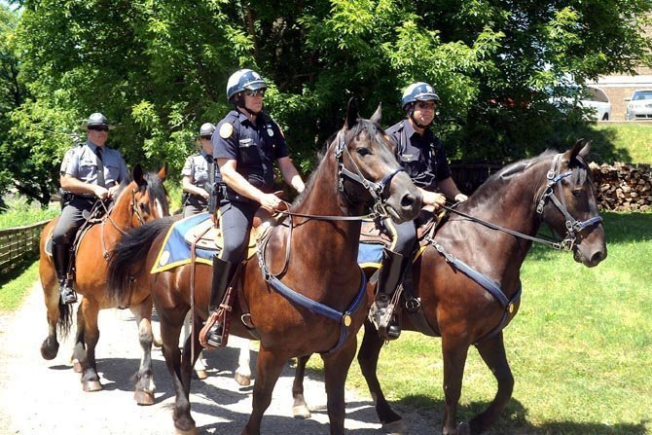
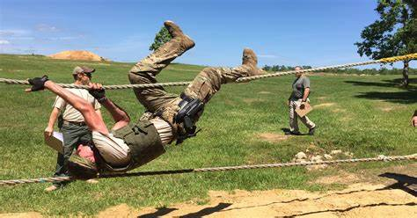
GOOD NEWS
Mental Illness is treatable
Talk therapy is not the only game in town
What is Experiential THERAPY?
Notes:
Good news
TALK THERAPY is not For everyone, especially first responders
What are other experiential modalities
Ropes courses,
Equine ,
YOGA
Massage therapy
Art, Welding
Acupuncture
Psychodrama
Medications
Exercise
Nutrition

Slide 14
General Mental Health Tips
Notes:
American Psychological Association
Get some help
SLEEP IS A WEAPON: Keep your sleep schedule
Get up and get dressed everyday
Do 3 things in the direction of your dreams
Morning meditation or mindfulness practice (insite timer meditation app)
Use Humor
12 step community has so many great slogans
Addiction: We look to those things that weaken us: food, substances, relationships, drugs, shopping
Look to things that
4 solutions to any problem: Solve it, Accept it, Change the way you feel about it or DO NOTHING

Slide 15
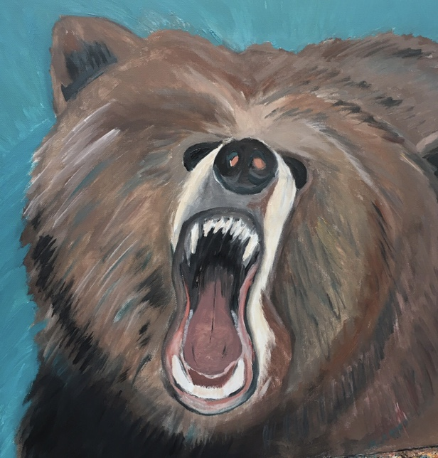
DBT: Distress Tolerance for Anxiety and Anger
TIPP
Notes:
TIPP skill
NEXT SLIDE

Slide 16
Mindfulness
Notes:
STAND UP
Belly Breathing

Slide 17
ACCEPTS: Emotion Regulation Skill
This Photo by Unknown Author is licensed under CC BY-NC
Notes:
ACCEPTS
Activities can regulate negative emotions
Contributing to others
Comparing this time in your life to one that you had it worst than this
Emotions: Generative opposite emptions to replace the negative one by doing the opposite of your action urge (e.g., if angry, gently walk away)
Pushing Away: Physically leave the situation to cool down (urge surf)
Thoughts: Filling short term thoughts with something that changes your emotions
Kinetic Self sooth using your 5 senses: Sight, sound, taste, smell

Slide 18
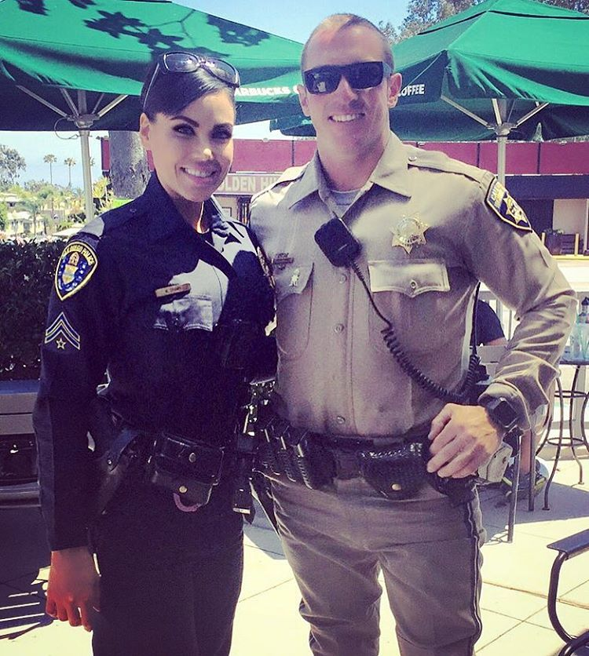
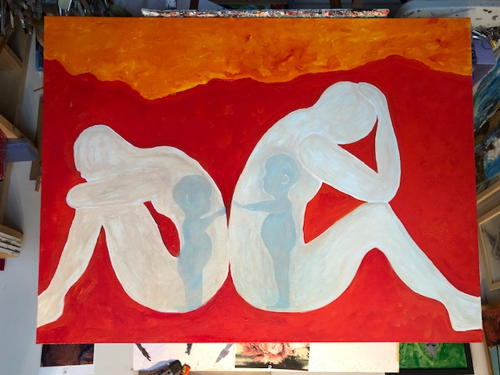
Unsolicited Relationship Tips
Divorce predators w/ 94% accuracy (Gottman and Gottman)
Criticism, Stonewalling, Defensiveness, Contempt
Takes 5 positive interactions for every 1 negative interactions
Negotiate
Apologize
Use Humor
Respond don’t react. Be Authentic!!
Chose your battles. Want to be right or happy
Blame implies intent—Did they really intend to irritate me?
Wise Mind
Lose the Battle to win the WAR
Notes:
Divorce predators w/ 94% accuracy (Gottman and Gottman)
Criticism, Stonewalling, Defensiveness, Contempt
Takes 5 positive interactions for every 1 negative interactions
Negotiate
Apologize
Use Humor
Chose your battles. Want to be right or happy
Blame implies intent—Did they really intend to irritate me?
Wise Mind: 24 hour rule
Lose the Battle to win the WAR in relationship

Slide 20
Teamwork is the Dream work
Notes:
You can ask for help

Slide 21
Dr.’s orders
Limit Screen Time
No selfish to take breaks
Mindfulness
Notes:
Deep Breathing EXERCISE
Stand up

Slide 22
Blue Zone Living
Notes:
GREECE, JAPAN, Costa Rica,
***Loma Linda, California This community has the highest concentration of Seventh-day Adventists in the United States, and some residents live 10 more healthy years than the average American by following a biblical diet of grains, fruits, nuts, and vegetables.
Making movement a natural part of your day
Knowing your sense of purpose
Prioritizing stress relief
Eating until you're about 80% full
Eating a largely plant-based diet
Drinking alcohol in moderation
Connecting with your community
Putting family (whether biological or chosen) first
Choosing social circles that support healthy behaviors

Slide 23
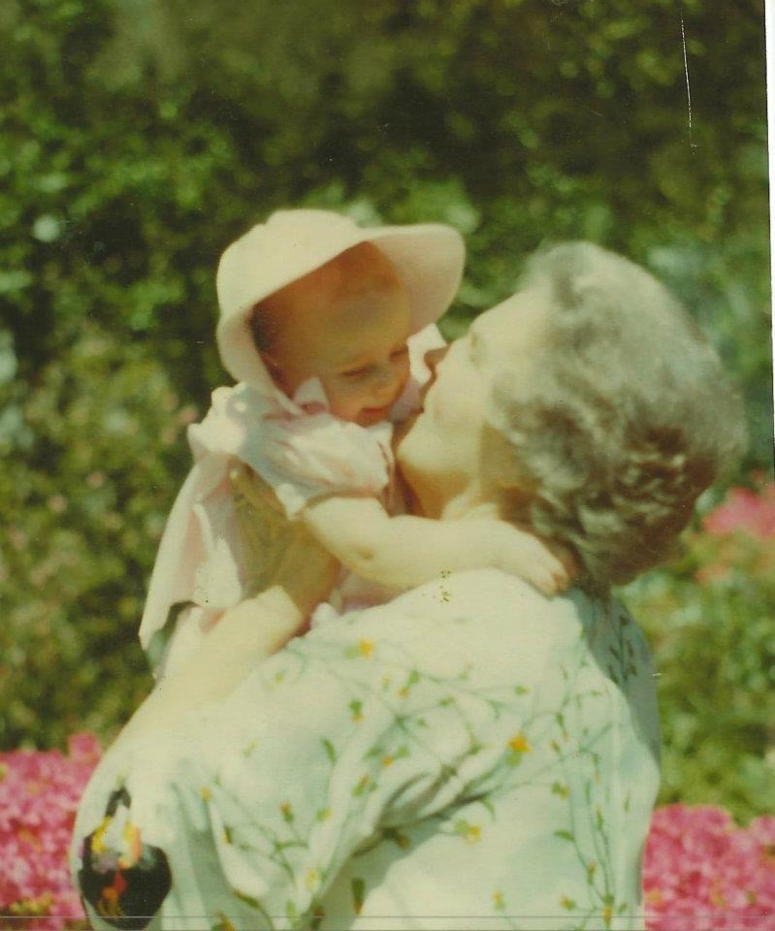
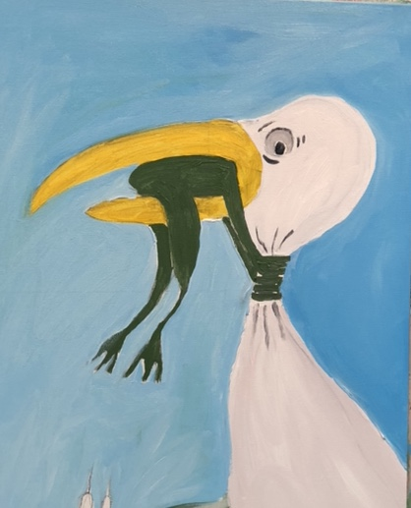
Grandmother Wisdom
Rule 1 Posture
Rule 2: Take Care of you
Rule 3: Successful community
Rule 4: Compare self to you
Rule 5: Raise Wise 50 year olds
Rule 6: Rule 6: Don’t blame others
Notes:
Simple Grandmother wisdom
Best Selling Book “12 rules for life: The anecdote for CHAOS” by psychologist Jordan Peterson.
Take responsibility for your own life.
Don’t worry about other problems – fix your own first.
3.. Acknowledge that life is suffering. Your goal is to make progress in the suffering. Overprotective adults avoid discussing suffering with their children, with the hope that it will protect them from it. This just makes children unprepared to deal with suffering when they run into it.
The 12 rules themes
"Stand up straight with your shoulders back."
"Treat yourself like someone you are responsible for helping."
"Make friends with people who want the best for you."
"Compare yourself to who you were yesterday, not to who someone else is today."
"Do not let your children do anything that makes you dislike them."
"Set your house in perfect order before you criticize the world."
"Pursue what is meaningful (not what is expedient)."
"Tell the truth – or, at least, don't lie."
"Assume that the person you are listening to might know something you don't."
"Be precise in your speech."
"Do not bother children while they are skateboarding."
"Pet a cat when you encounter one in the stre

Slide 24
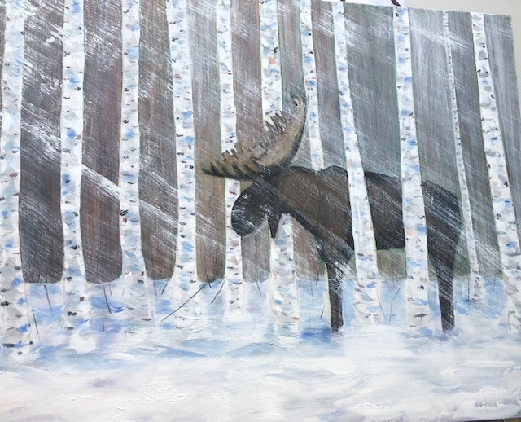
Killebrew Psychological Services
Fitness for Duty
Psychological Evulation
Notes:
Fitness for Duty
Psychological Evulation
We all have symptoms of mental illness but do they cluster and are they severe
Treatment and early intervention are key

Slide 25
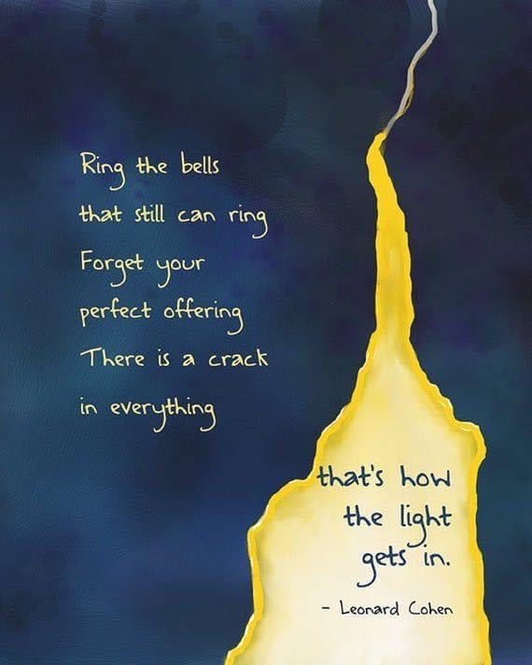
YOU WERE NEVER BROKEN
Notes:
A poem that saved my life: You were never broken
It takes Courage to Stop Running
Trauma is invisible force that keeps us running, restless, in pursuit of some intangible goal. Caught up in some unnecessary activity. Addiction. Compulsion. Distractions. Makes us escape into thinking. Makes the body feel unsafe. Makes the present moment into an enemy. If we slow down. If we stop. If we rest. If we simply do nothing. Then we will have to face…ourselves. We will have to face buried feelings. All the shit we were running from. All the darkness. The gunk. The muck. The longlines. The ache and the boredom. The night and the emptiness. Trauma says “Run” Trauma says “Do not stop” Trauma says just keep going. Trauma says “stopping is unsafe.” We start by proving to ourselves that it is safe to rest. Safe to be still. Safe to do nothing. Just for a moment. Safe to think our thoughts and feel our feelings. And not “fix” the moment in any way. We can begin-one moment at a time-to digest all the undigested things inside. Stay with sadness for a moment longer. Be present with our joy or shame for an instant more. Breathe into our anxiety instead of running from it. Become curious about discomfort instead of distracting ourselves with unnecessary food., drink, cleaning, drugs, sex, shopping, internet, thinking, talking, overworking, yoga, seeking, more thinking, rumination, fantasy and false hope. We can challenge the core story at the heart of trauma. That the present moment is unsafe. That the body is somehow working against us. That feelings, sensations, or thoughts are dangerous. That stillness and silence equal nonexistence and death. And that we have to “do” something in order to be worthy, and loved and whole. It takes courage to stop running. It takes courage o lean into the storm. It takes courage to touch the darkness inside with infinite light of our curious attention. It takes courage to break the addiction to futures. And be present and breathe and know.

Slide 26
Questions?

Slide 27
HELP IS ON THE WAY
Notes:
TAKE AWAY MESSAGE: HELP IS ON THE WAY!!!!!!!!!!!!!
We are here to continue to support you and WE LOVE YOU AND ALL YOU DO TO KEEP US SAFE

